Slide 1
Programming 4
04.1 2D Amination Algorithms
Semester 2, 2019

Slide 2
2D animation algorithms
Continue to develop our understanding of OO architecture
New computational approaches
How animation works from a human cognition perspective
Notes:
In order to create an awesome Roguelike, we need sprite animations
We will look at how to implement sprite animations in Visual C++
This process will let us continue to develop out understanding of OO architecture
We will begin with very brief discussion of how animation works from a human cognition perspective
Today we will consider the initial architecture of our animated sprite class
Over the next couple of weeks, we will add additional features to this class

Slide 3

2D animation algorithms
The production of the illusion of movement by rapid representation of a series of still images

Slide 4
2D animation vs 3D animation
Presentation of a series of pre-rendered static images
Often thought as traditional animation
Focuses on creating sprites, storyboards and backgrounds in 2D environments
Sprites can move up, down, left and right
They don’t appear to move toward or away from
the user as they would in 3D animation
2D animation uses bitmap and vector graphics
Notes:
2D and 3D are completely different things
N, E, S, W – cardinal
N, NE, E, SE, S, SW, W, NW – ordinal
We will be using bitmaps going forward
You can create your own graphics using Adobe Photoshop

Slide 5
2D animation vs 3D animation
Images computed on the fly from mathematical
models of the scene
An image is defined as a set of X, Y, Z vertices in
a 3D coordinate space
To update/move, the location of each vertex is computed
Creating a 3D sprite requires four separate parts:
Modelling
Rigging
Skinning
Animating

Slide 6
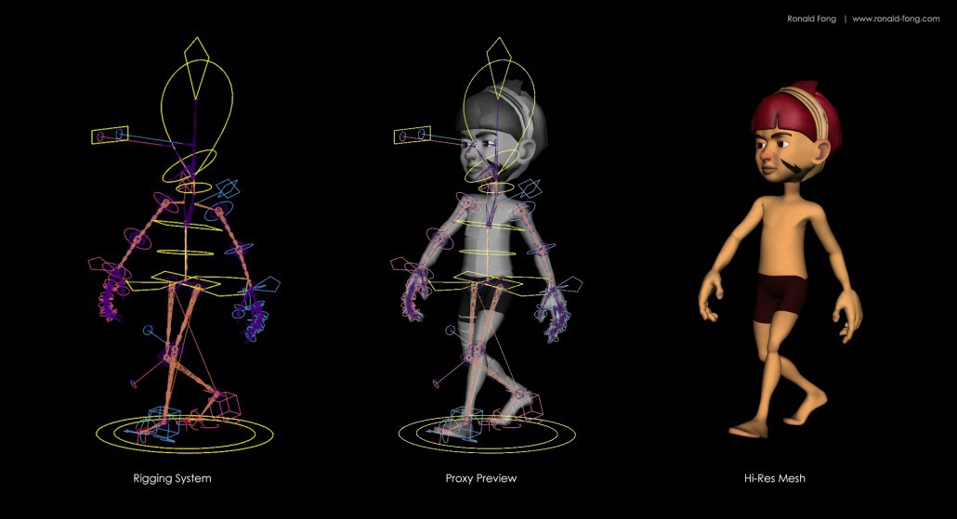
3D animation – modelling
When creating 3D models:
Must be careful when defining the structure of the surface
The structure defines how well it is suited for an animation
Notes:
Structure – orientation and type of polygons

Slide 7
3D animation – rigging
Process of creating the bone structure
The bone structure is a set of helper objects
The bones will be animated and the character will
move and deform accordingly
Bones itself won’t show in the final rendered image

Slide 8
3D animation – skinning
Process of defining how the character responds to
the movement of the bones
One goes through all the joints in the bone structure
Carefully adjusts how the 3D model deforms while
a certain bone is moving

Slide 9
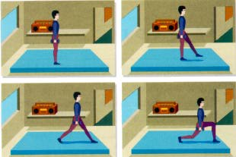
Frame-based vs Cast-based
Frame based animation is the simpler of the two techniques
Involves simulating movement by displaying a
sequence of static frames
When the frames are shown in rapid succession,
they create the illusion of movement
There is no concept of an object distinguishable
from the background
Notes:
This is an important point because it distinguishes frame-based animation from cast-based animation

Slide 10
Frame-based vs Cast-based
Also called sprite animation
Very popular form of animation
Involves objects that move independently of the background
For example, in the animation of a jungle, the trees
and plants might be part of the background, but a monkey would be a separate object moving independently of the background

Slide 11
Sprite sheets
Image that consists of several images and/or
animations
Combining several images into one improves:
Game performance
Reduces memory usage
Sprites are generally square
A sprite sheet is X pixels high and Y pixels wide

Slide 12

Sprite sheets – blobbo
In the practical today, we will be using this sprite
sheet
Notes:
If we drew each little square of blobbo onto the screen in rapid succession, it would look like a moving blobbo – twists from side to side
Sprite sheets usually have a background colour, for example, fuchsia
The method is to tell your rendering class to draw all the pixels from the sprite sheet that aren’t the background colour
You can work with a convenient rectangular shape, but only the sprite itself shows
This is called making the background transparent, but more accurately, it is simply not drawing the background pixels at all
We will use a .NET class to do this

Slide 13
Drawing from a sprite sheet
We have been using instances of the Image class
Image^ gnomeImg;
gnomeImg = Image::FromFile(“gnome.jpg”);
canvas->DrawImage(gnomeImg, xPos, yPos);
Notes:
We declare an Image^, initialised it with the static FromFile method and display it on the screen by handing it off to canvas->DrawImage
We always used the whole image, and drew all of its pixels including the background (white area of our gnome image)

Slide 14
Drawing from a sprite sheet
Now we need to:
Draw only a portion of the pixels
Notes:
Blobbo sprite sheet contains many frames of animation
We need to draw a portion of the sprite sheet image at a time
Animation works by displaying the frames in turn, so we want to draw the first frame, then the second frame…
Here you see blobbo appearing without it’s fuchsia background – we will discuss in a minute
Each blobbo has the whole sprite sheet with its 8 frames
Note how each of them is showing only a single frame-sized square from the whole sprite sheet

Slide 15
Drawing part of an image
DrawImage
Image^ pathToFile
int xLocation // canvas
int yLocation // canvas
Rectangle rectangle // source
GraphicsUnit::Pixel
Notes:
Rectangle rectangle = Rectangle(currentFrame * frameWidth, 0, frameWidth, frameHeight);
Frame width is calculated by taking the width of the sprite sheet and dividing by the number of frames
xLocation and yLocation is where we are drawing on the canvas, usually the form
Rectangle is four values – X, Y, width and height of the what you want to draw on the canvas
GraphicsUnit tells it that we are using px rather than other units such as cm and em

Slide 16
Drawing part of an image
Notes:
Let’s see if we can draw just a portion of this very big image
Say starting at 1000, 400 of the image and being 200 wide and 200 high
We will draw that piece of the gecko onto the Form

Slide 17
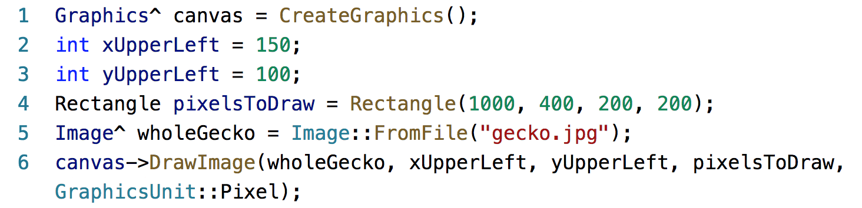
Drawing part of an image
Notes:
This will copy the area of the gecko image with upper left at 1000, 400 and lower right at 1200, 600.
It will draw those pixels at location 150, 100 on the Form.
1000, 400 is in the image’s coordinate space and 150, 100 is in the Form’s
Note that Rectangle is a primitive in C++/CLI. You don’t gcnew it.
Note GraphicsUnit::Pixel. That is one of the .NET enum types. You will do this sort of thing a lot when working with .NET.

Slide 18
Using a sprite sheet – selecting frames
Assume you know frameWidth and frameHeight
Assume the sprite sheet has n frames (0 to n-1)
Frame | Rectangle to draw
0 | 0, 0, frameWidth, frameHeight
1 | frameWidth, 0, frameWidth, frameHeight
2 | 2 * frameWidth, 0, frameWidth, frameHeight
3 | 3 * frameWidth, 0, frameWidth, frameHeight
…
n-1 | (n-1) * frameWidth, 0, framewidth, frameHeight
Notes:
For example, blobbo is 32 x 32 pixels – frames are often square, but don’t have to be
For reasons that will become clear, we think of the frames as being numbered from 0 to n-1, like the locations in an array
What are the pixel rectangles, in the coordinate space of the sprite sheet that we want to display?

Slide 19
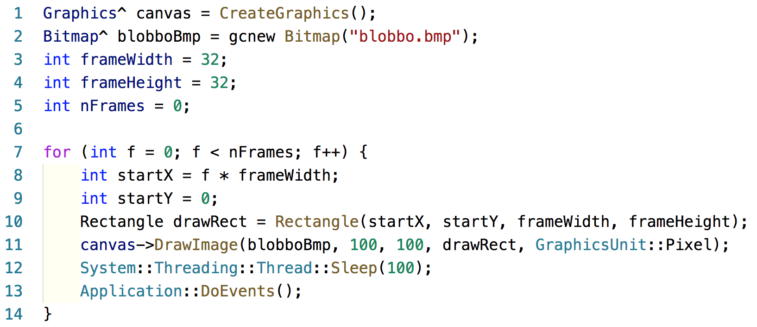
Using a sprite sheet
Notes:
We draw each frame at 100, 100 on the form. But the pixels we are taking from the image are changing
Now what if we want to add this behaviour to a Sprite class. We want our Sprite class to be able to draw itself
Each time we call its draw method, we want to see the next frame
We call the draw once at each game cycle
So no for loop, and no for loop driver. We need to find a different way to keep track of which frame we are on

Slide 20
Sprite class animation
The class needs to know:
What Graphics^ it should draw to
It sprite sheet image
Its frame dimensions
The frame it is currently on
The class needs to be able to:
Draw itself:
Compute the correct rectangle of pixels to display
Draw them to its Graphics^ object
Update it current frame

Slide 21
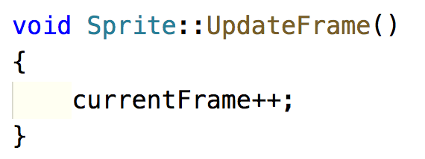
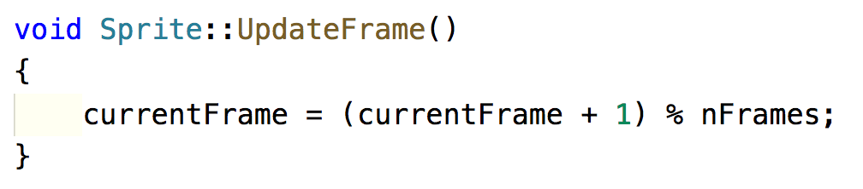
Updating current frame
Notes:
As long as we make currentFrame a class data member, we can update it in one method (UpdateFrame) and use it in another method (Draw)
Assume blobbo has 8 frames. 0, 1, 2…7 is fine, but when you get to 8, you will be asking for a pixel position that is actually off the sprite sheet – causes flickering
For repeating animation like blobbo, we need to loop back around from n-1 to 0
That is 0, 1, 2…7, 0, 1…
Fortunately, this is exactly what the modulo operator does. Increment the value by 1 (1 frame) and the take the mod n of that result and when it reaches n, it loops back to 0 – because the remainder of n/n = 0
Questions to ask students:
Where, and to what, do we initialise currentFrame? In the constructor and to 0
Why do we make a separate method for updateFrame, rather than just add that code to Draw()? Because updating the frame is not part of drawing. We can easily imagine situations where we want to control drawing and updating separately. This is an OO thing: one method, one job
How does animation happen? The consuming class must call Draw(), Update() in a loop. Also, possibly Erase() depending on the implementation. Or, you can provide a wrapper method that bundles them up

Slide 22
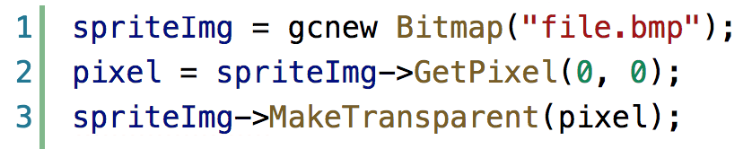
Implementing transparency
We can no longer us Image class
Must use Bitmap, a more complex descendent
of Image
Bitmaps have a method MakeTransparent
MakeTransparent accepts the transparent colour
When you draw a Bitmap instance, any pixels of the nominated transparent colour are not drawn
Notes:
Fortunately, bitmaps expose a GetPixel method that does exactly what you need here

